Slide 1
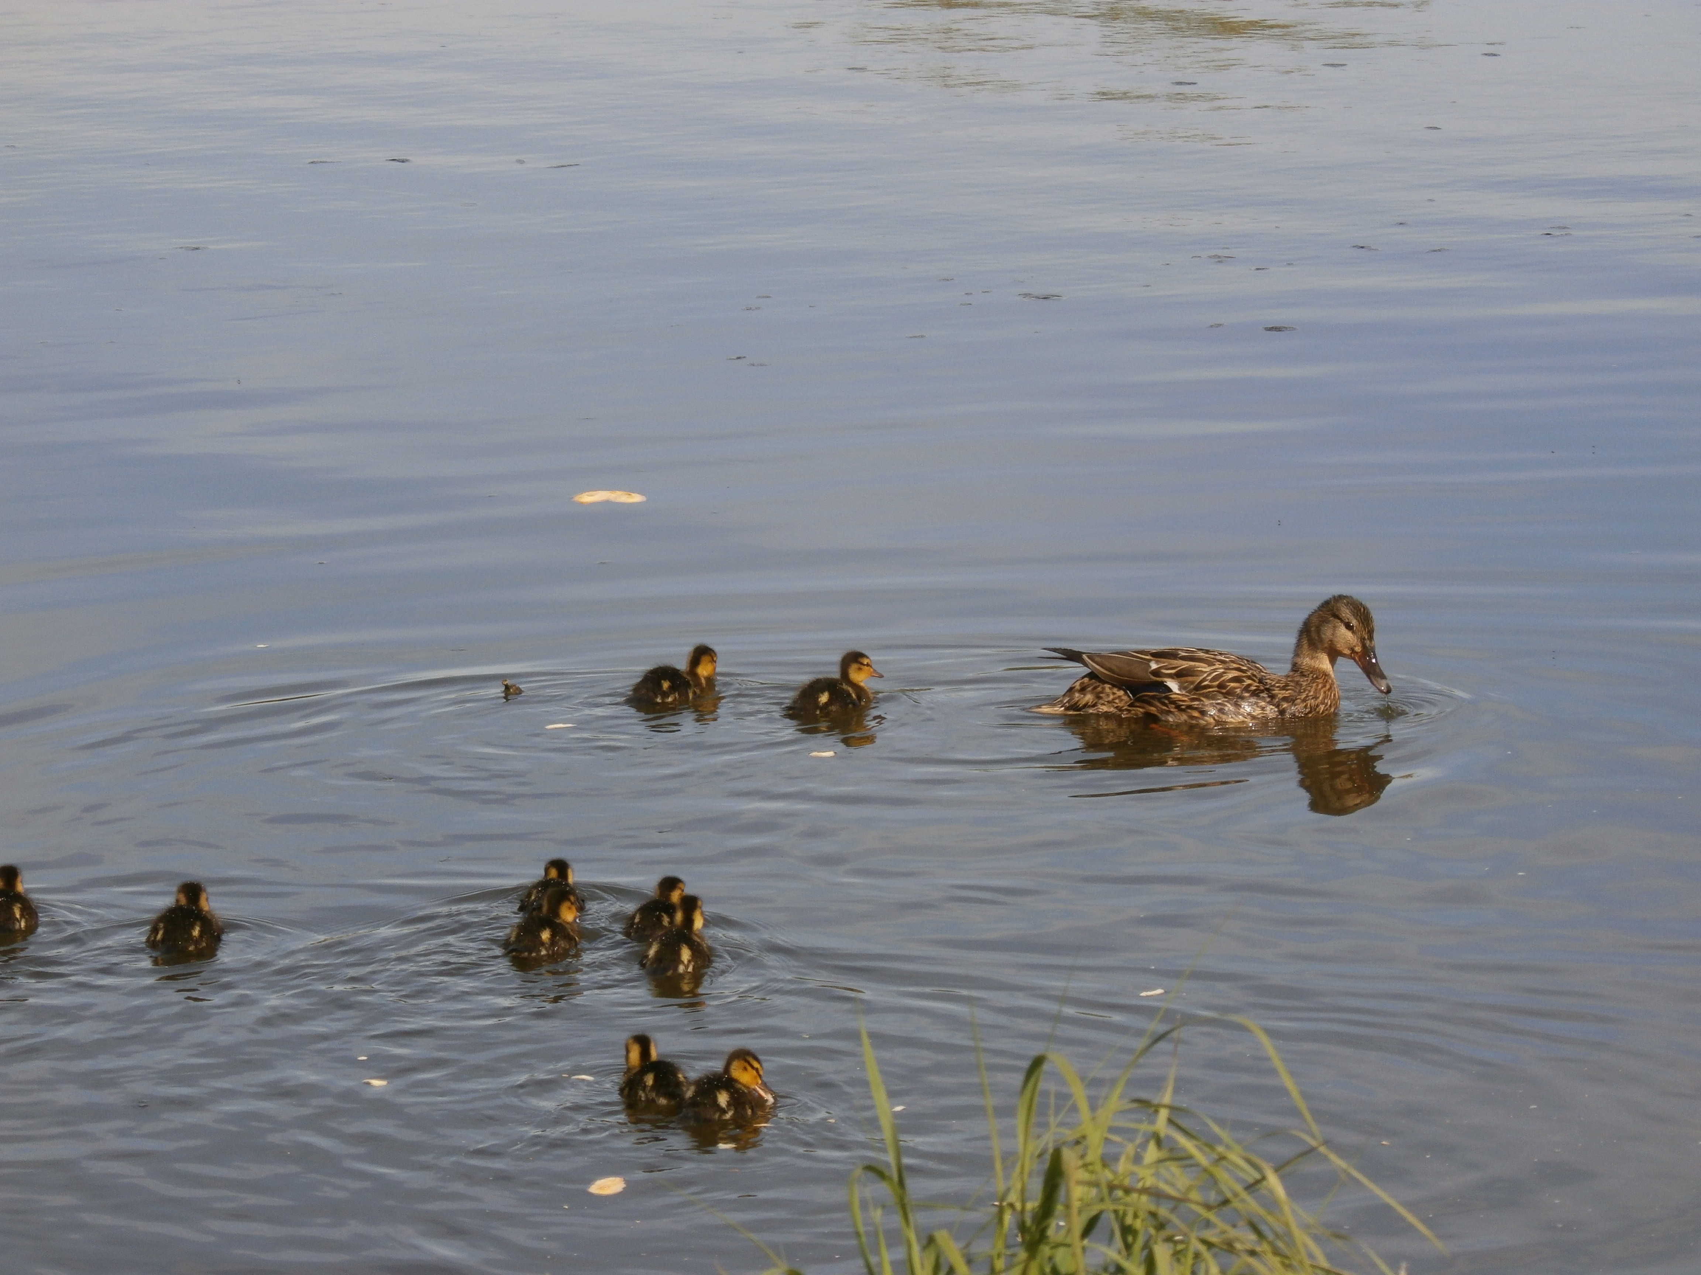
Leadership
StePPING INTO THE LEADERSHIP ROLE
Barbara Ridener
FAU

Slide 2

Keeping your ducks in a row

Slide 3
Takeaways
Leadership is different from Administration/Management
Your leadership style
The big picture
Communication
Lead by example
Relationships are important

Slide 4

All Eyes Are On You!

Slide 5
Leadership is not the same as management
Not just business as usual
Have a vision in mind
What are the puzzle pieces?
How do they fit together?
Prepare others who can do your job
Notes:
A chair who is an academic leader has the ability to support faculty as they develop while helping them mesh into a dynamic group that flows and moves forward as a department.

Slide 6
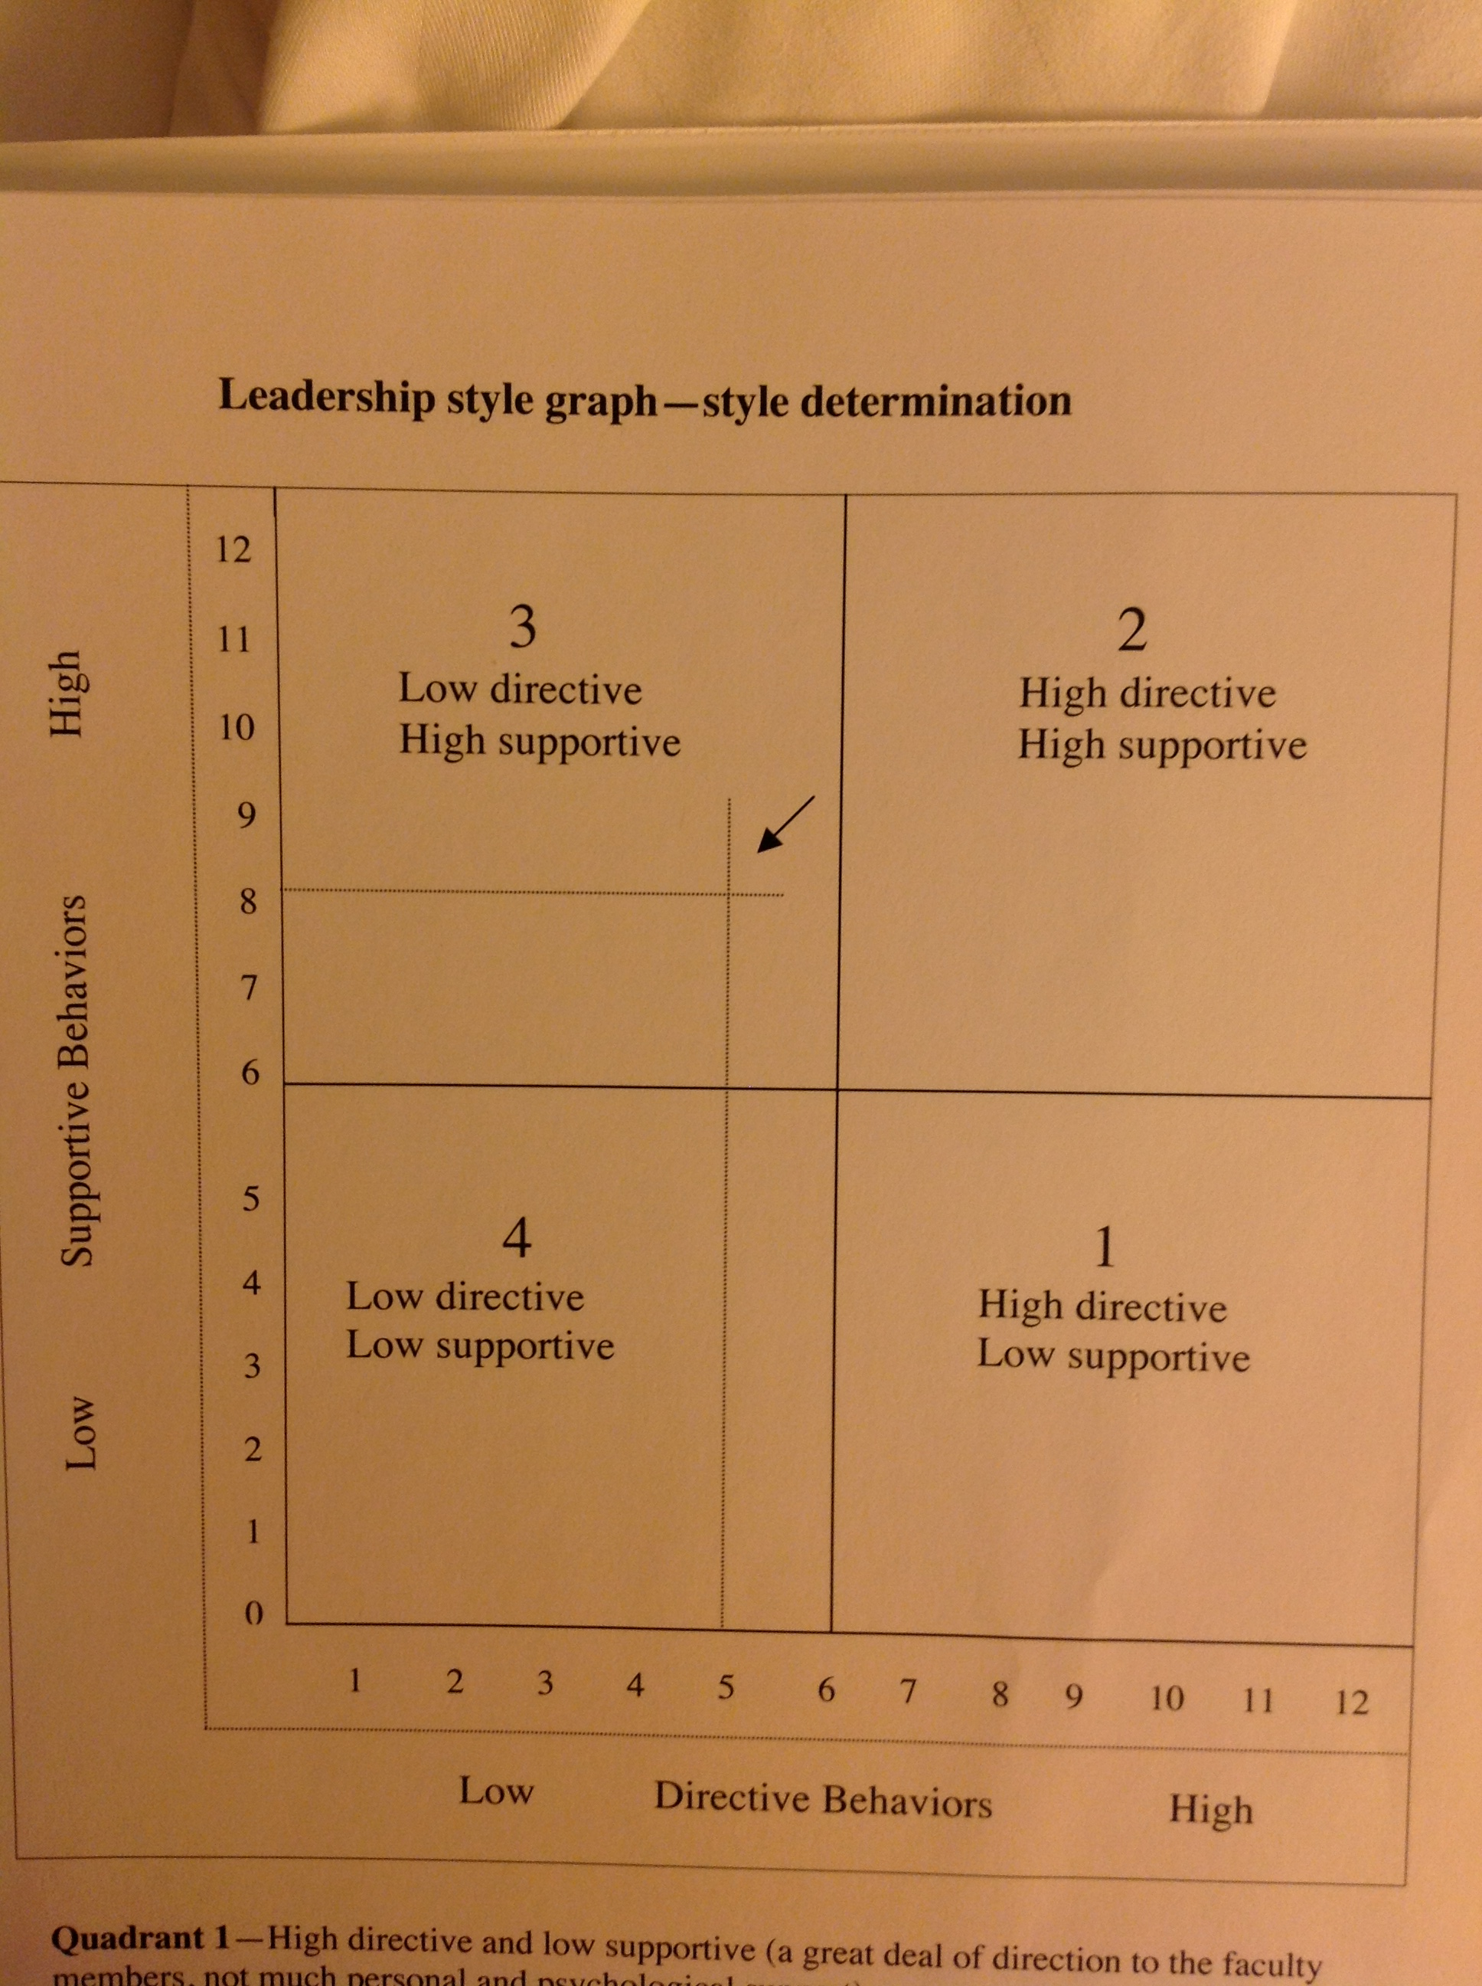
Your leadership style
Identify your style.
Your style will influence your interactions.
Your style will influence your decision-making skills.
Your style can help develop your technique.
You can’t copy someone else’s style.

Slide 7
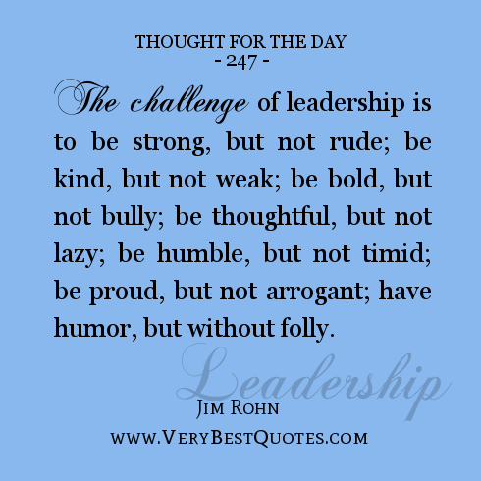

Slide 8
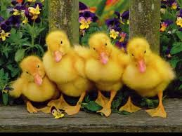
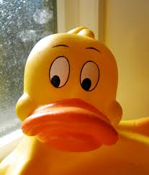

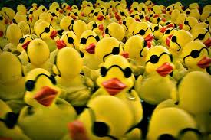
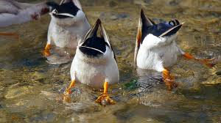
Prioritize Needs and Decide Course of Action
What is the department doing now?
Why are we doing it?
Can we do it better? How?
What does the dean expect?

Slide 9
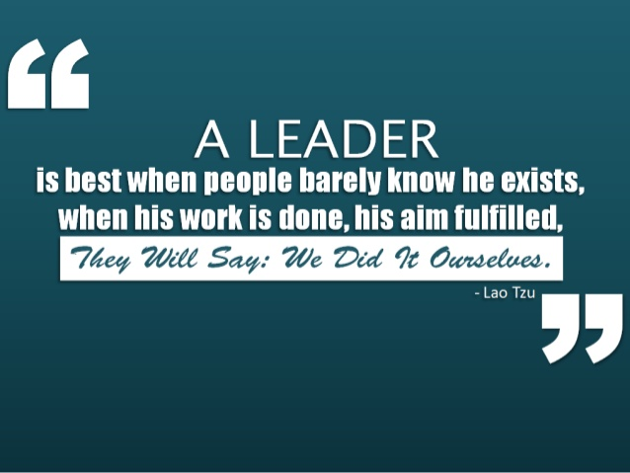

Slide 10

See the BIG picture
Balance needs of department and college
Don’t rely just on favorites
Get used to wearing multiple hats
Knowledge is power, it gives you the ability to make decisions with confidence

Slide 11

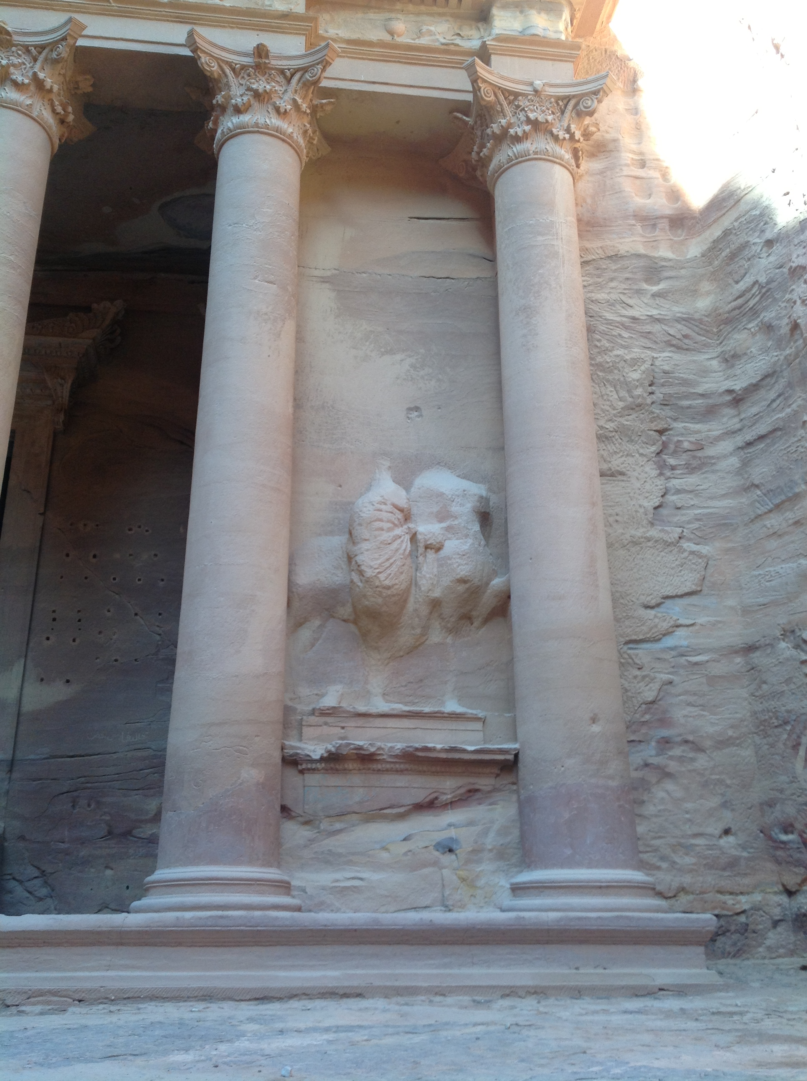

See the BIG picture

Slide 12
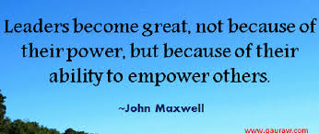

Slide 13
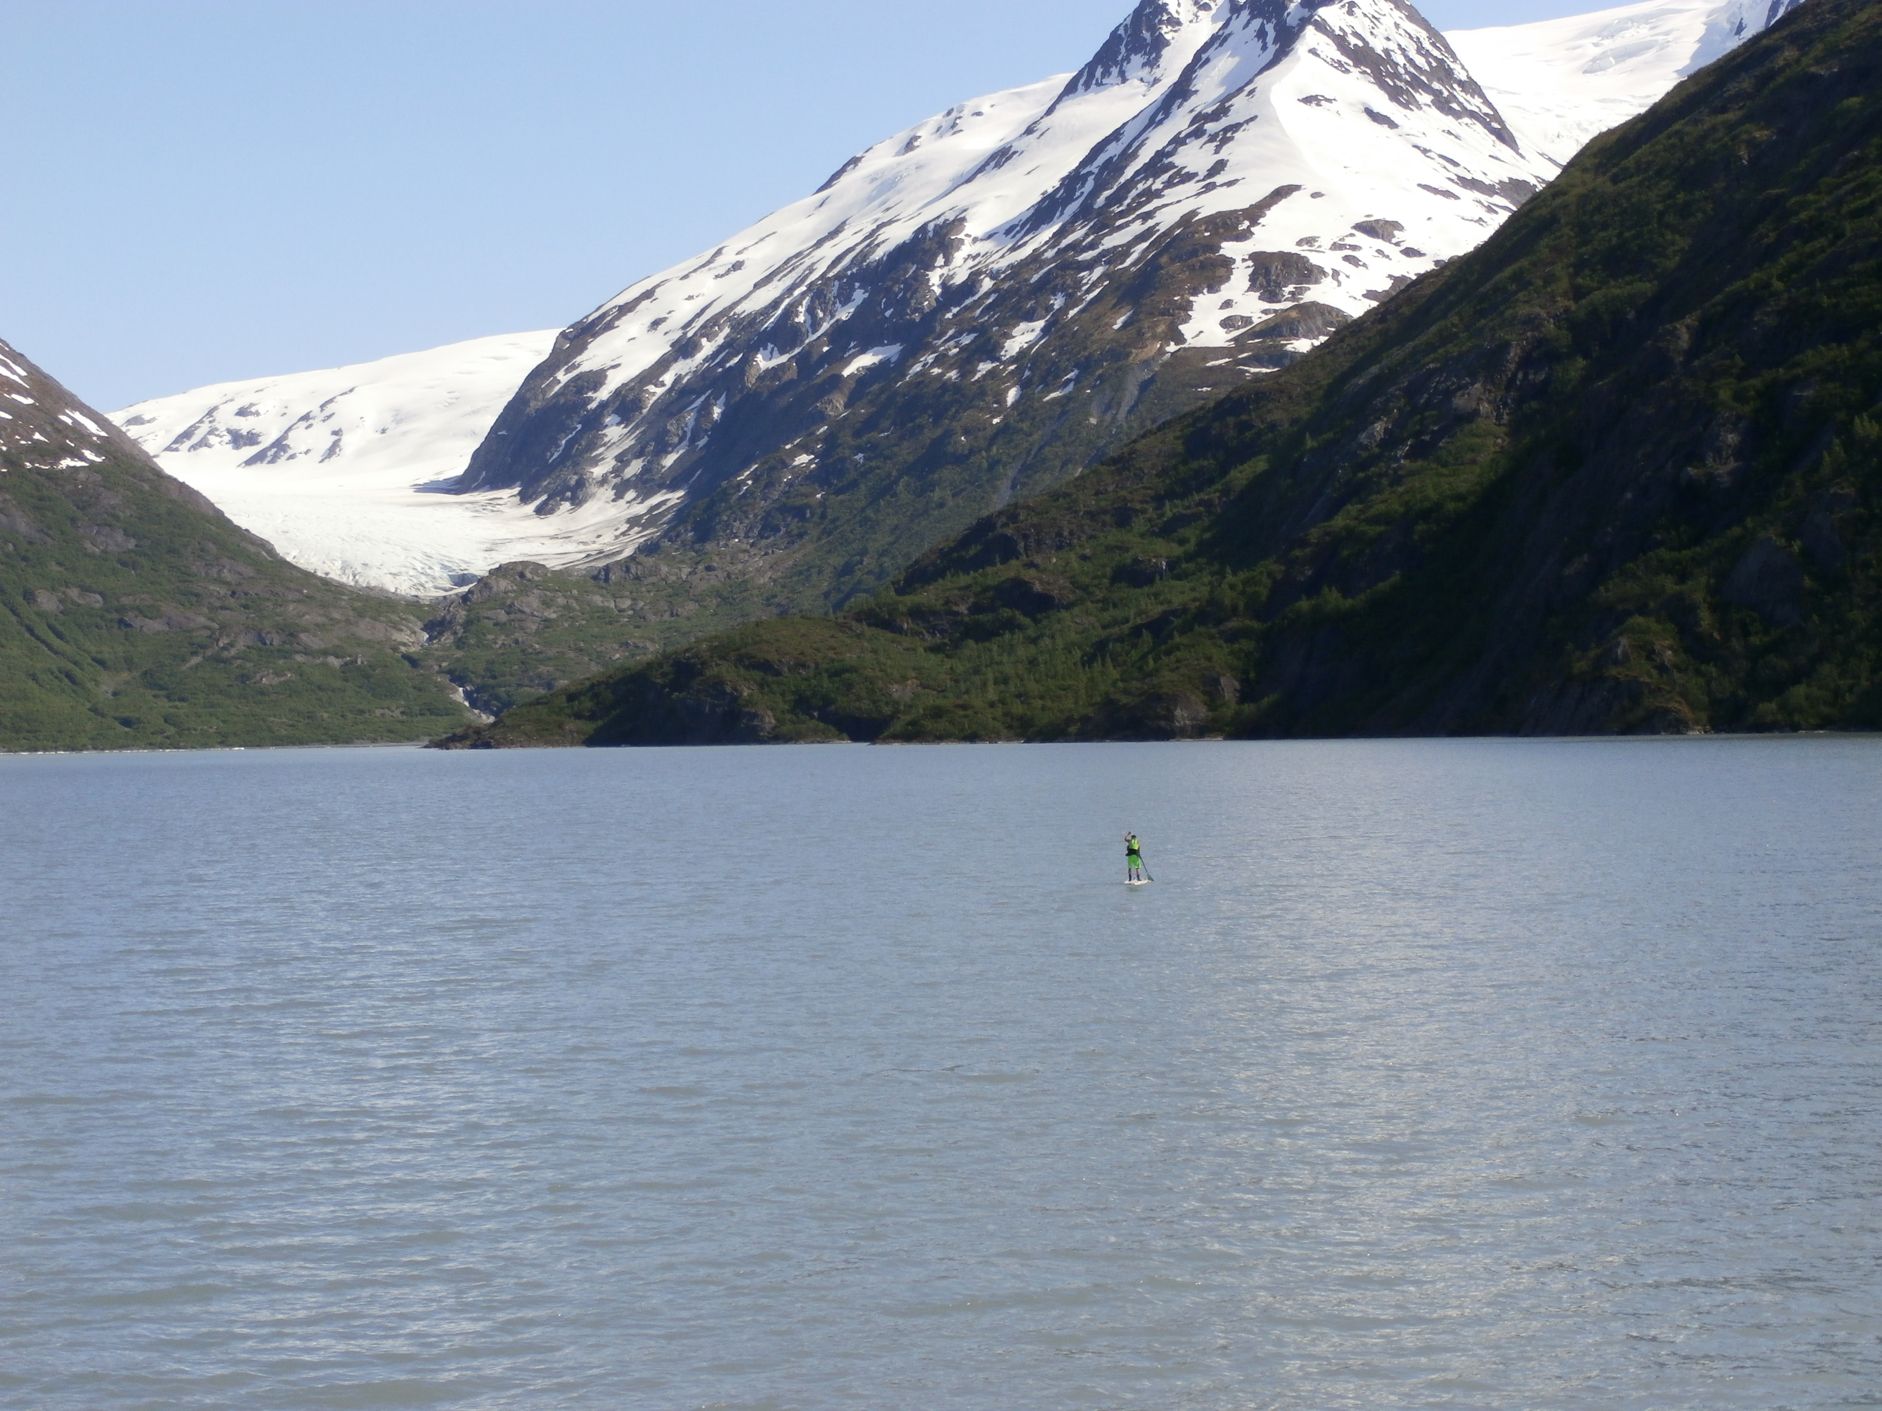

Sometimes Look Beyond the Big Picture

Slide 14
What is your lens?
How do you lead those who may not want to be lead?
How do you lead those who are hungry for direction?
How do you negotiate a department that has both?
What does leadership look like:
From your perspective?
From the faculty’s perspective?
From the Dean’s perspective?

Slide 15


Slide 16
Communication
Listen to concerns, ideas and feedback
Be direct
Make responses timely, but you ask for requests in writing to give you time to consider your response
Think before you write
Admit mistakes
Be aware of body language

Slide 17
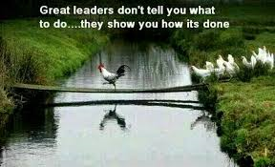

Slide 18
Lead by example
Faculty will watch you….
…..and scrutinize everything you do!
what time you arrive
what time you leave
who you talk to
how you dress
how you respond to email
…and everything else you haven’t yet thought of

Slide 19
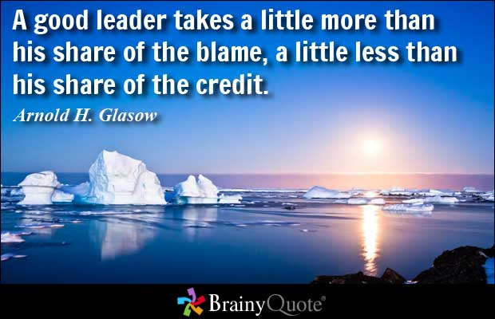

Slide 20
Relationships
If you are new…(or not)
Get to know everyone
Take time
Listen
Get off your “turf”
If you have been there…(or not)
You are the boss
Old friendships may not work the same
You can’t do this job wanting to always be liked

Slide 21
Celebrate Success!
The college
The department
The faculty
The students
It’s worth it!

Slide 22
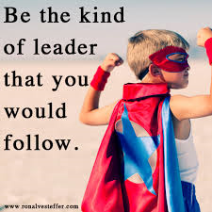
You can be a great leader!

Slide 23
Over time I’ve learned more and more and over that time, I’ve found that less and less is really important.
R. E. Lamond

Slide 24

Even though you may sometimes feel you might be running against the wind!
http://www.youtube.com/watch?v=aCA-r3YCkUo

